Slide 1


Moving the Needle on Performance for FDRC
A Preliminary REVIEW
Darrell Kent
March 11, 2024

Slide 2
Agenda
A review of the input data
A review of the questions
My read on what the data indicates in terms of answers – and further questions
Some thoughts on possible further areas of pricing opportunity
A bonus topic

Slide 3
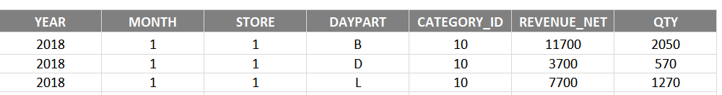


Our input consisted of 4 data sets. A preliminary review indicates that we have at least reasonably clean data.

Slide 4
Our Initial Questions for FDRC
How has the revenue and customer count changed between 2019 vs 2018?
What is driving the change in customer count? Ex. Region, State, Daypart etc.?
When comparing revenue for 2019 vs similar months in 2018, which Regional Director is facing the biggest challenge? (and why)
What is a forecasted revenue for 2019? Briefly explain your forecast methodology. Give suggestions on how you would improve this if you had more time/data.
What can you tell us about price changes and its possible impact on the business?
If you could create one key graph for the Executive team that paints the story for 2019, what would you graph? Create that graph!
Based on this data are there any recommendations you would make to management?

Slide 5
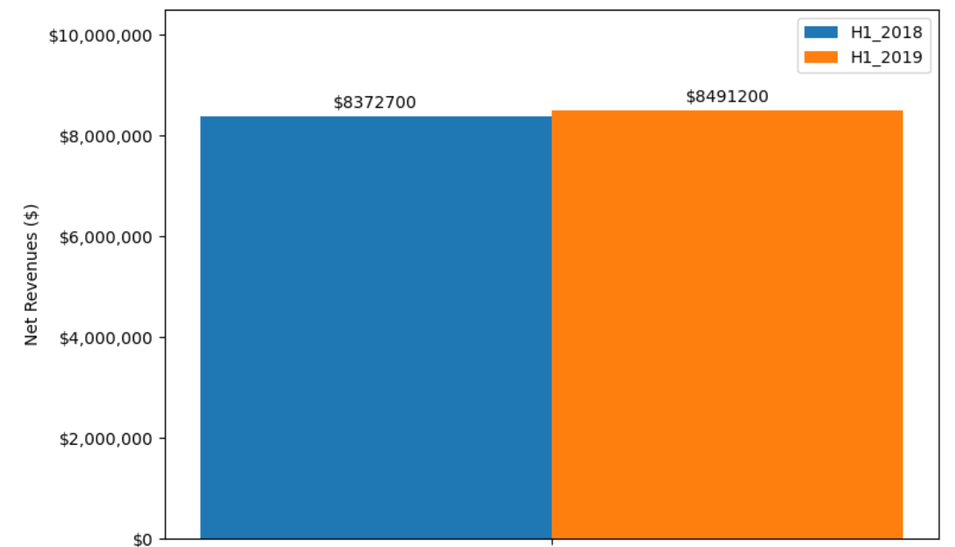
Overall, FDRC is doing ok – our sample store set saw net revenue growth of 1.4% in 2019 over 2018.

Slide 6
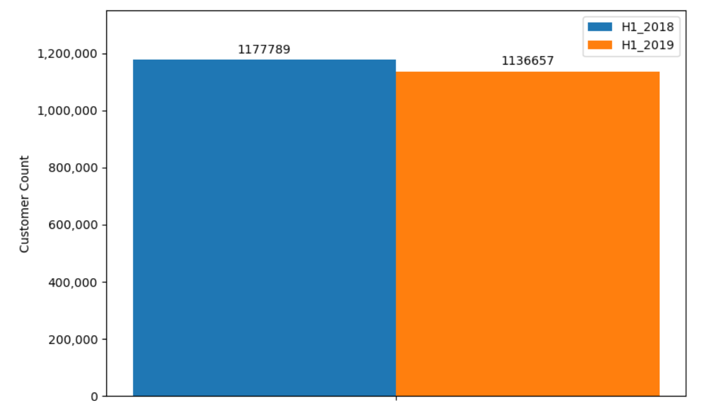
However, there is a somewhat worrying trend with a 3.5% decline in customer counts across the group.

Slide 7
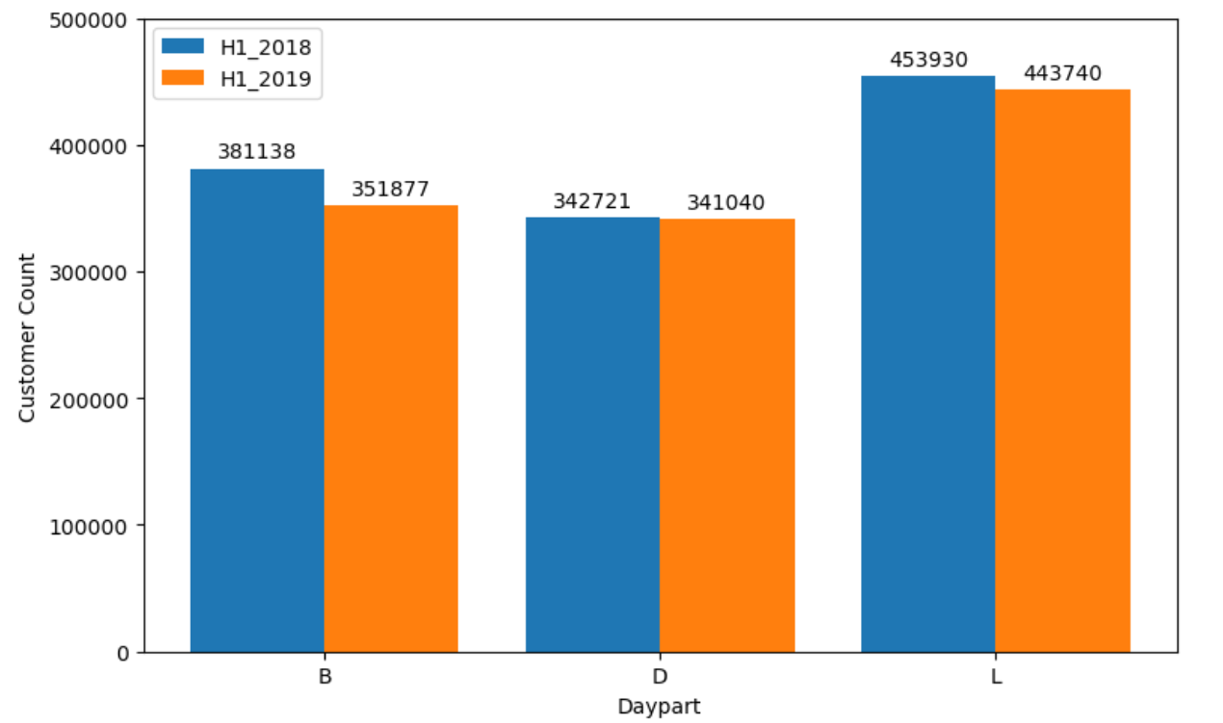
The breakfast and lunch dayparts accounted for the bulk of the decline in customer counts.

Slide 8
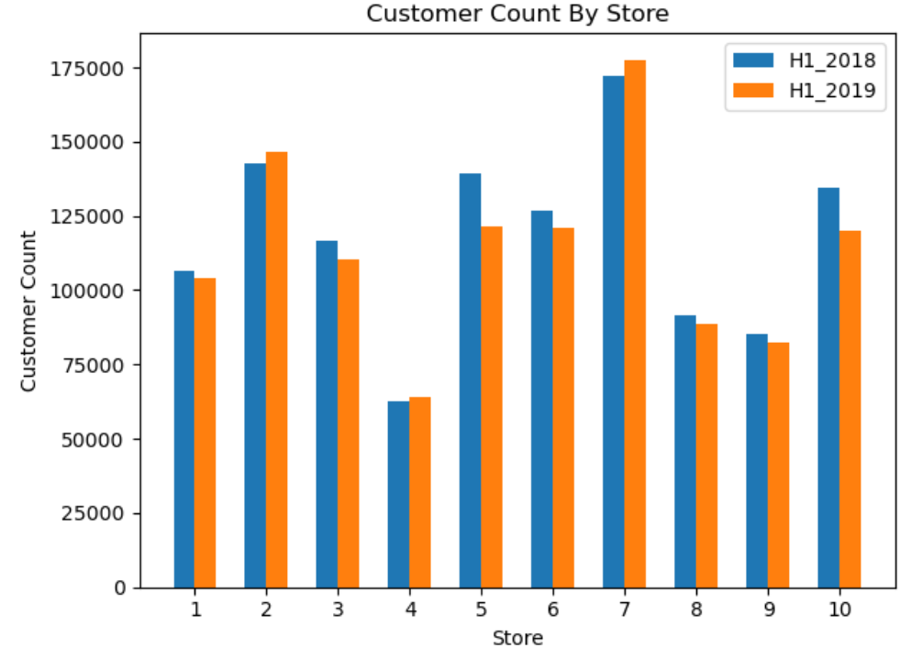
At the store level, we observe that Store 5 (-13%) and Store 10 (-11%) saw the most significant customer count declines.

Slide 9
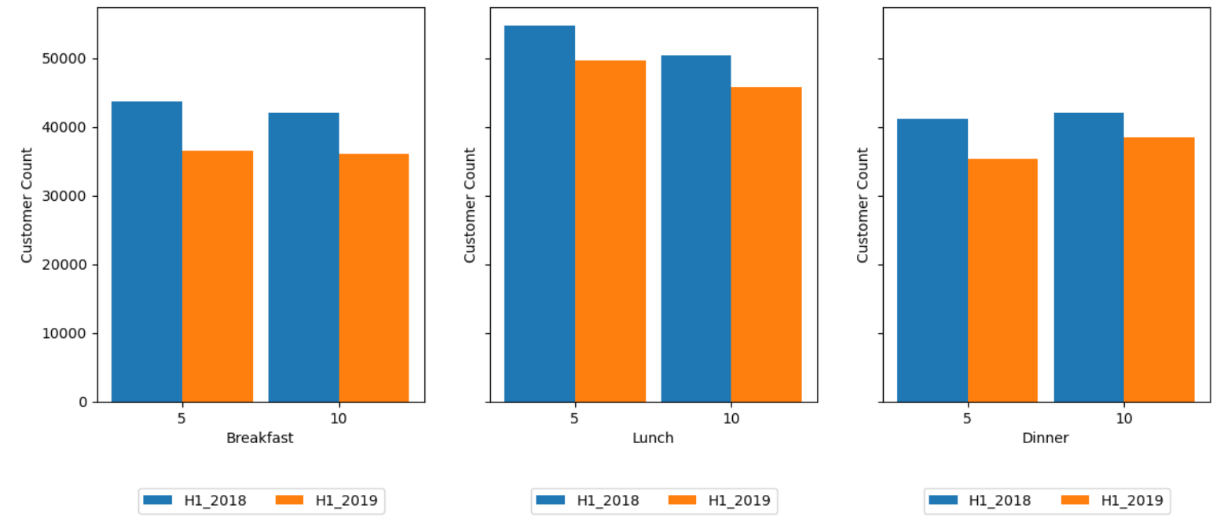
Stores 5 and 10 saw declines across all three dayparts in the 5 to 15% range.

Slide 10
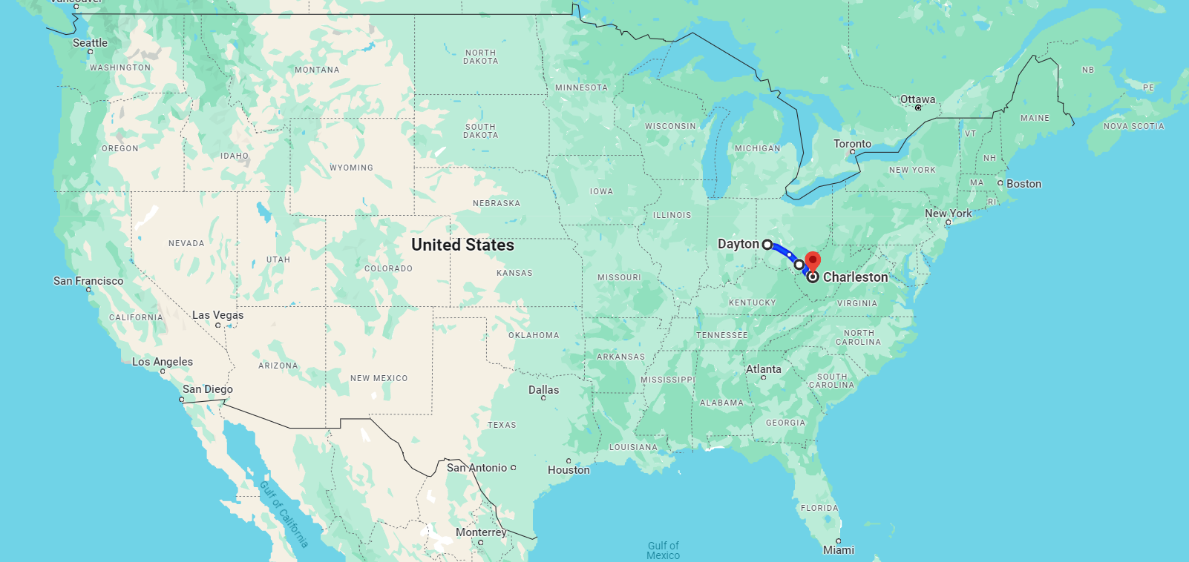
A conversation with Joe Green should likely be a near-term next step.
all three of Joe’s stores are seeing customer count declines
of the 6 stores that saw declines, Joe is responsible for three of them
Joe’s 3 stores are within a 4-hour driving distance diameter

Slide 11
Caution: There is some indication in the data that price is not fundamentally the issue.
Question: What explains the declining customer counts?
labour shortages
sub-standard or inconsistent service
problems otherwise with how the strategy is being operationalized
a new competitor has arrived on the scene
price – customers in general have become more price sensitive
price – segment(s) of customers have become more price sensitive

Slide 12
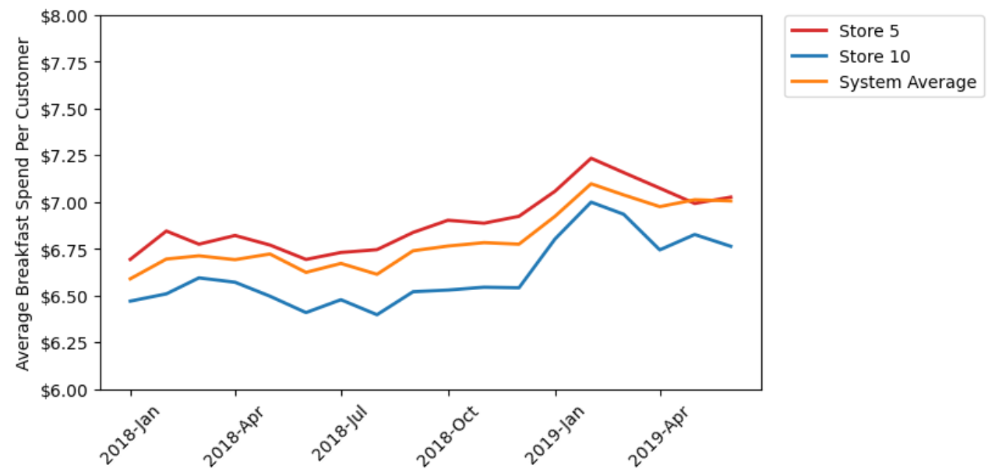
Average spend per customer in stores 5 and 10 is tracking system trends - suggesting price is not a driver.
Were most of Joe’s customers becoming more price sensitive, we would expect to see a decline in average spend per customer – which we are not.
Were a segment of Joe’s customers becoming more price sensitive, we would expect to see a faster rate of increase in average spend per customer relative to the system average – which we are not.

Slide 13
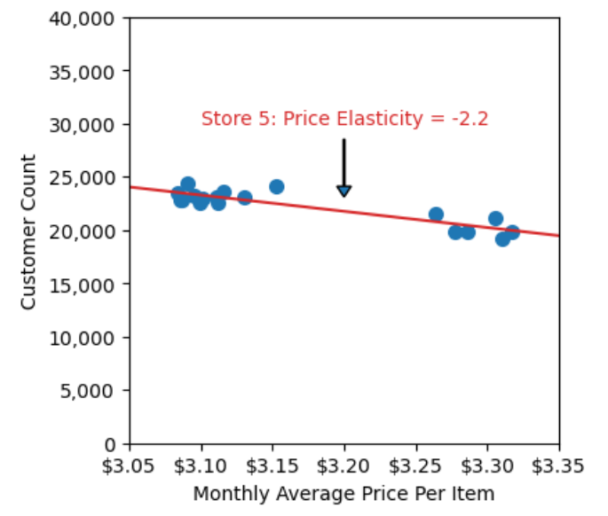
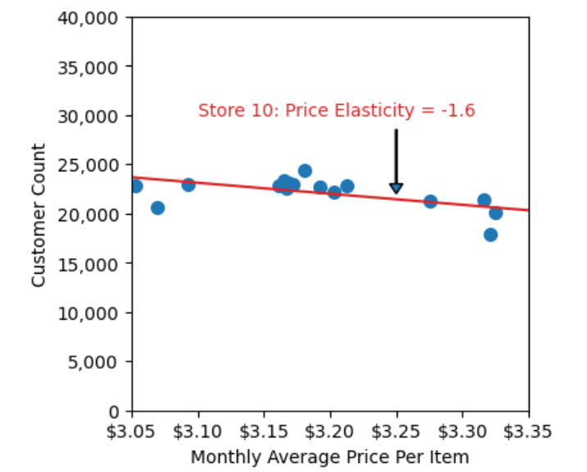
Quasi-price sensitivity models suggest elastic demand – but better price and cost data likely needed for optimization.

Slide 14
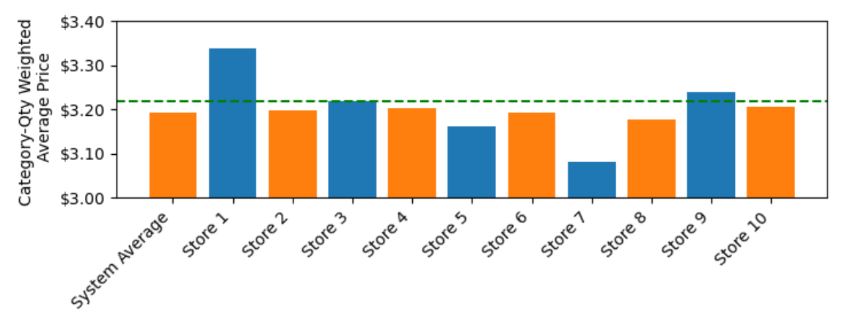
Key Graph #1: Prices appear to vary across stores. Taking prices up to the 75th percentile level is likely a safe early-win opportunity.
75th Percentile Category-Qty Weighted Average Price

Slide 15
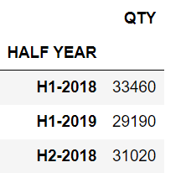
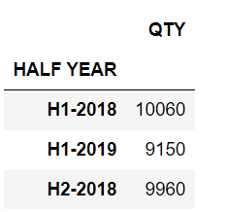
Key Graph #2: With Store 5, we see some softness in both strategic categories – likely warranting further attention
Senior Category:
Kids Category:
If we are seeing these kinds of declines in strategically important categories:
Is our strategy being operationalized in a reasonable fashion?
Is our strategy still fit for purpose?

Slide 16
Key graph #3: Why is average spend per customer growing ~2x as fast as core inflation?
Possible Drivers:
FDRC is taking price increases beyond core inflation. But are these changes helping profitability?
FDRC is seeing traction with new higher end menu options. Is this helping profitability?
A new competitor is taking share from FDRC at the low end – possibly indicating a disruptive threat.

Slide 17
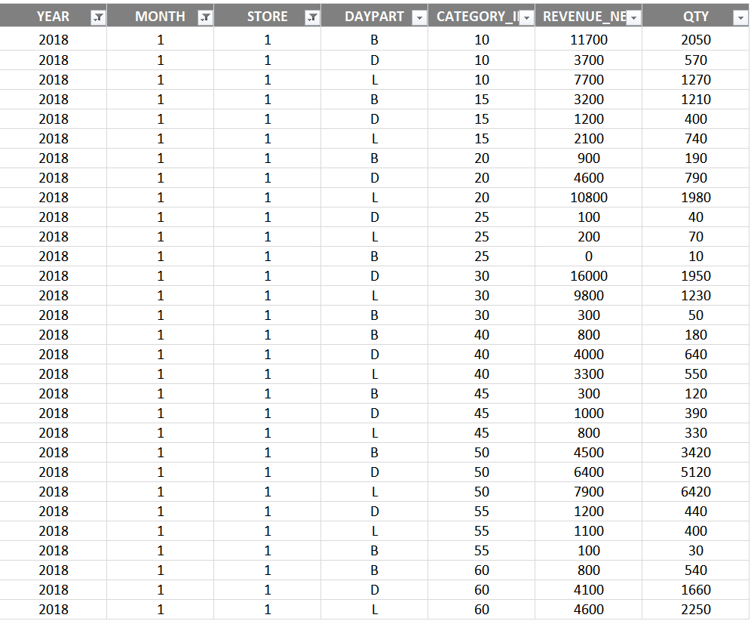
One caveat . . . the pricing calculations in this analysis are very simple groupings across dates and stores . . .
Possible Issues:
We may have very different mixes across dayparts and categories between stores.
We may have very different mixes within dayparts and categories between stores.
We are thinking about: Are there approaches to producing price data that reflect these differences.

Slide 18
Beyond Joe’s issues, a five-point framework might be useful in uncovering further pricing-related opportunity.
Advancing Customer Insights:
customer segmentation
buying group mapping
customer value criteria identification and assessment
economic value modelling
price sensitivity estimation
Advancing Price Structure Design:
price-offer configuration
price metrics (i.e. the unit to which a price is applied)
segmentation fences (i.e. fixed criteria the customer must meet to qualify for a lower price)
Advancing Price Level Planning:
iterating towards price levels that maximize key outcomes
Pricing Execution:
the approach to communicating price and value
pricing policy
approach to assessing pricing performance
approach to collecting relevant external data
Influencing More Favourable Industry-level Pricing Conduct:
profit and culture
monitoring competitor actions
pursuing constructive cooperation
selectively increasing price transparency

Slide 19
The Decision Inventory as a Tool for Uncovering Opportunities.

Slide 20
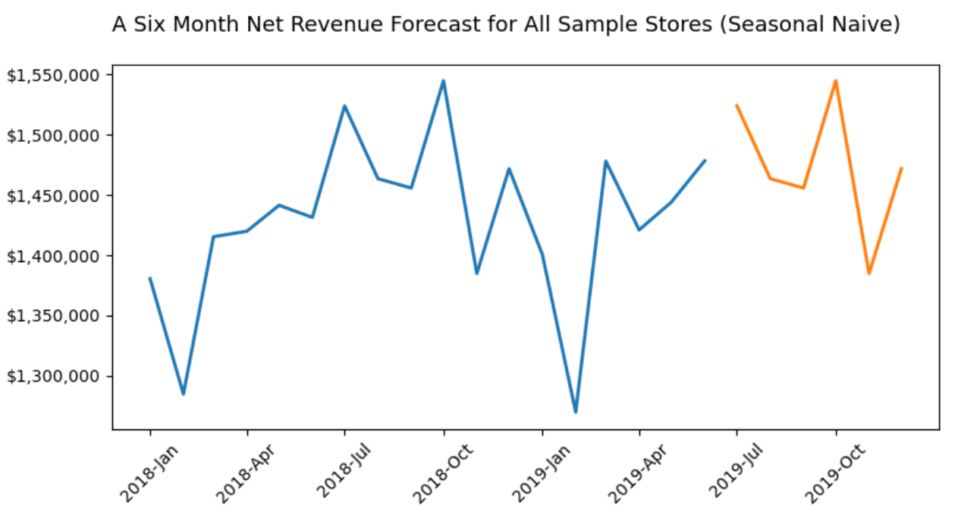
Re forecasting: The limited amount of data and the small amount of signal in the data make forecasting a challenge.
Some possible opportunities:
further develop the business problems that a better forecast might address
data for more months
resampling what we have as weekly data
looking beyond the system-wide revenue level
with more signal, look at time series models beyond seasonal naive
looking at SARIMAX and other modeling-types that factor in exogenous variables
adding a model evaluation regime
approaches that include and utilize uncertainty

Slide 21
What would RML be getting with me?
someone who will roll up his sleeves and do the work
someone with some technical skills
an enthusiastic mentor of developing talent
maybe: RML’s next conjoint specialist
a useful contributor to the firm’s visibility-building efforts
a passionate contributor to RML’s intellectual capital
an able business developer – someone who can bring in some work
Bonus: Is known to be a little bit of fun from time to time. ☺

Slide 22
Questions? Thank-you again!

